Slide 1
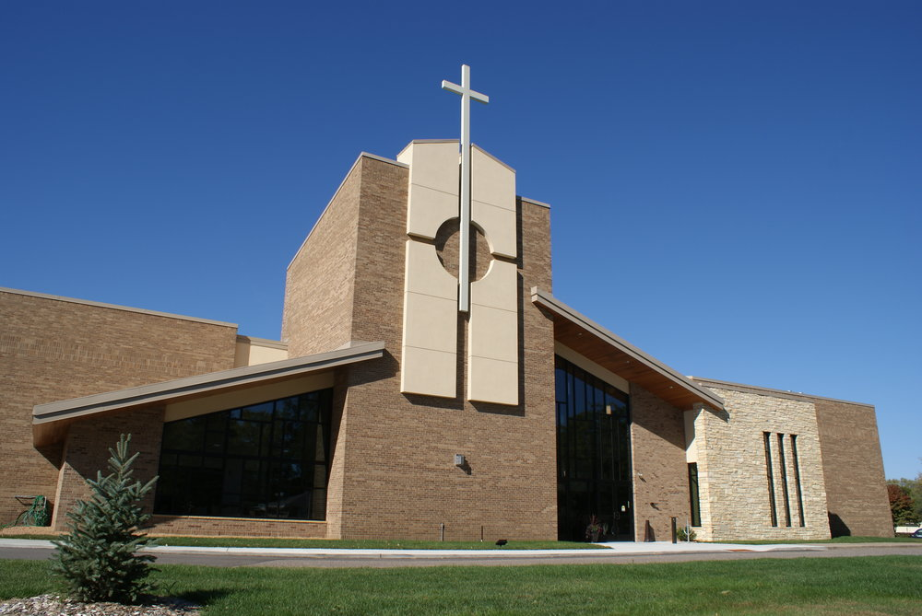
All of our congregations have a hi-STORY
How well do you know yours?
How well do your people know your story?
Does your congregation keep archives?
How are they shared with the congregation?
How do new folks learn your story?
If someone asked, “Who IS this congregation and how did you get to be who you are?,” would you feel equipped to answer?

Slide 2
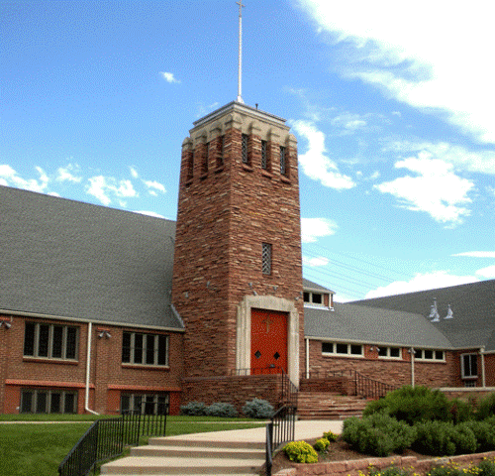
Knowing AND telling our stories is important
When we know our story, we know who we are and why we function the way we do
It helps us keep the main thing the main thing
It gives us the data we need to do any healing that may be necessary; chart the next chapter our course
It keeps us honest: Are we who we think we are? Or are we attempting to paint a rosier picture? Or a more negative one?

Slide 3
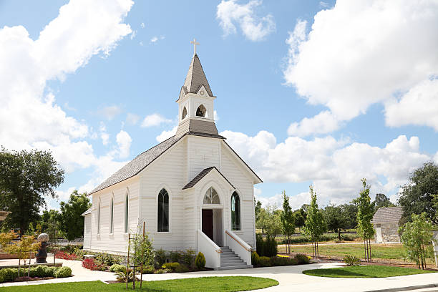
One way to do storytelling in your context: Have a storytelling party!
Create a timeline – with pastors and their years of service plotted out ahead of time, along with any other major milestones
Use a horizontal line that plots church moments above – and any significant community events/changes below
Invite folks to tell stories of important moments (good or bad). Encourage them to elaborate, as one person’s memories might jog another’s
When finished, reflect together: What does this tell us about who we are?
Post the final product (or a tidied-up version) in your fellowship hall, narthex, or another high-traffic area for all to see

Slide 4
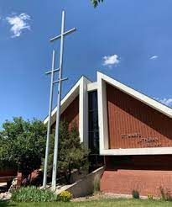
History of Pastors at St. Mark's
Ward
1988-1989
Interim
Oberleiter
1979-1980
Interim
Herman
2005-2008
Interim
Nelson
1984-1988
Assistant and Associate
1953
1963
1973
1983
1993
2003
2013
Hanson
1957-1966
Johnson
1980-1985
Resigned after sexual misconduct
Hofer
1989-2005
Retired after this call
Tange
1952-1956
Feucht
1986-1988
Senior Pastor
Died while in call
Rappath
1966-1979
Longbrake
2008-2018
Oberleiter
1982-1984
Returned as Assistant
Notes:
Add your own dates and event details to the flag markers. Move the flags along the timeline to match your event dates. Copy and paste a flag to add more.

